Slide 1
Four Facts about Finnish Basic Education

Slide 2
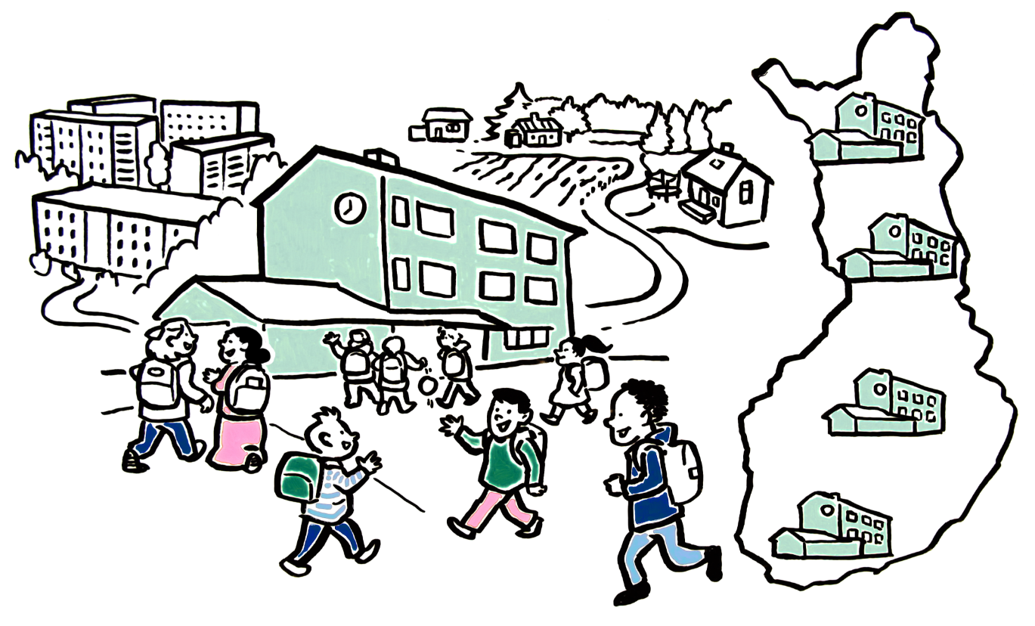
Equal opportunities
In Finland, everyone has equal opportunities to grow and learn. All schools follow the same national curriculum and basic education is free for everyone.
Let’s take a closer look!

Slide 3
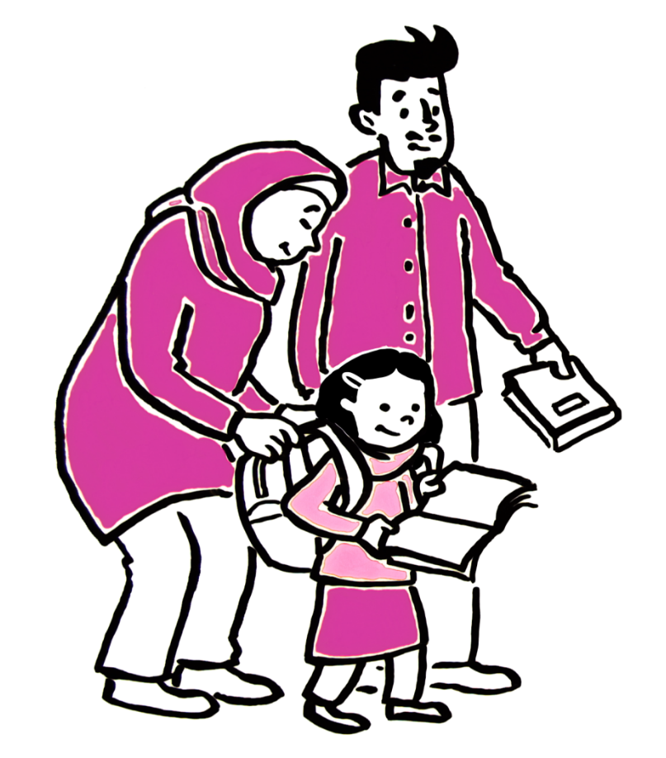
1. Compulsory education
Everyone has the right to education,
but also the obligation to complete their basic education.
A child’s guardians are responsible for ensuring they attend school.

Slide 4
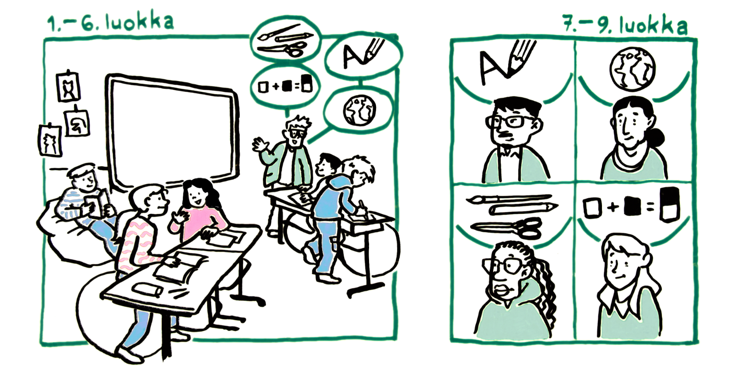
2. Teachers
In primary schools, the majority of subjects are taught by a dedicated class teacher. In the lower secondary school, subject teachers teach the specific subjects they are specialized in.
All teachers are highly educated professionals. There are also other education professionals working in classrooms to support students.

Slide 5
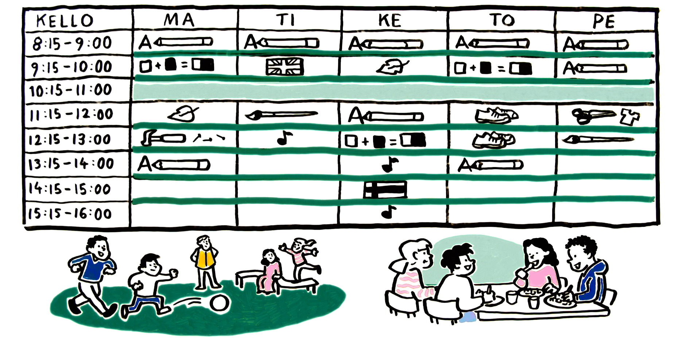
3. School days
Students study a variety of subjects throughout the day, according to their study schedule. There are breaks, or recesses, between lessons.
Free school meals are offered to all students during the school day.

Slide 6
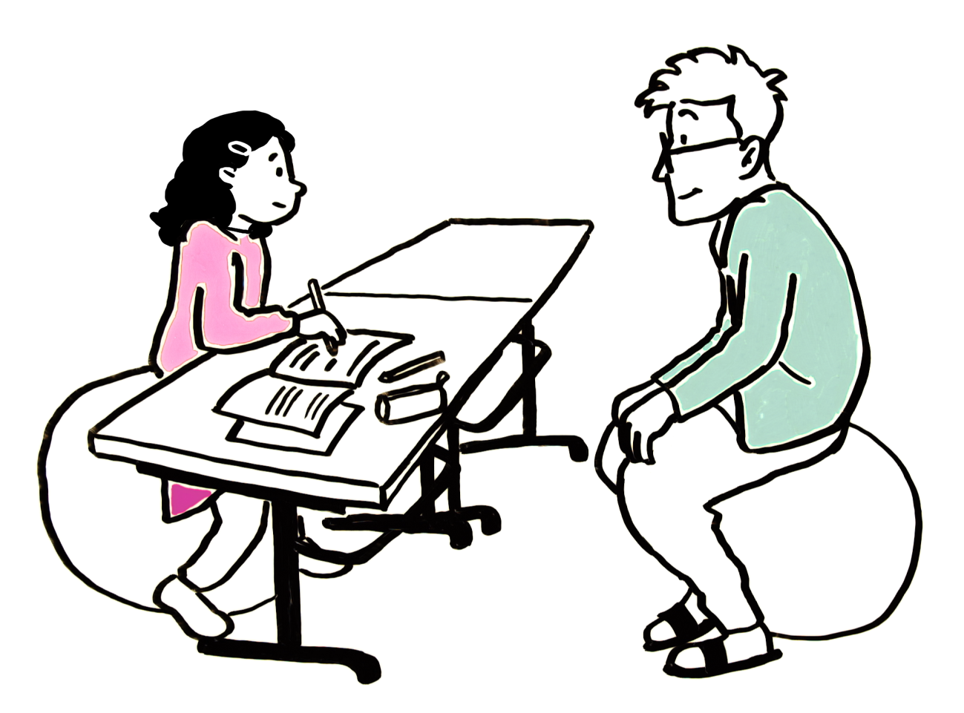
4. Evaluation
Teachers evaluate children’s learning and work.
They do not compare students to one another – the purpose of evaluation is to provide encouragement and support.

Slide 7
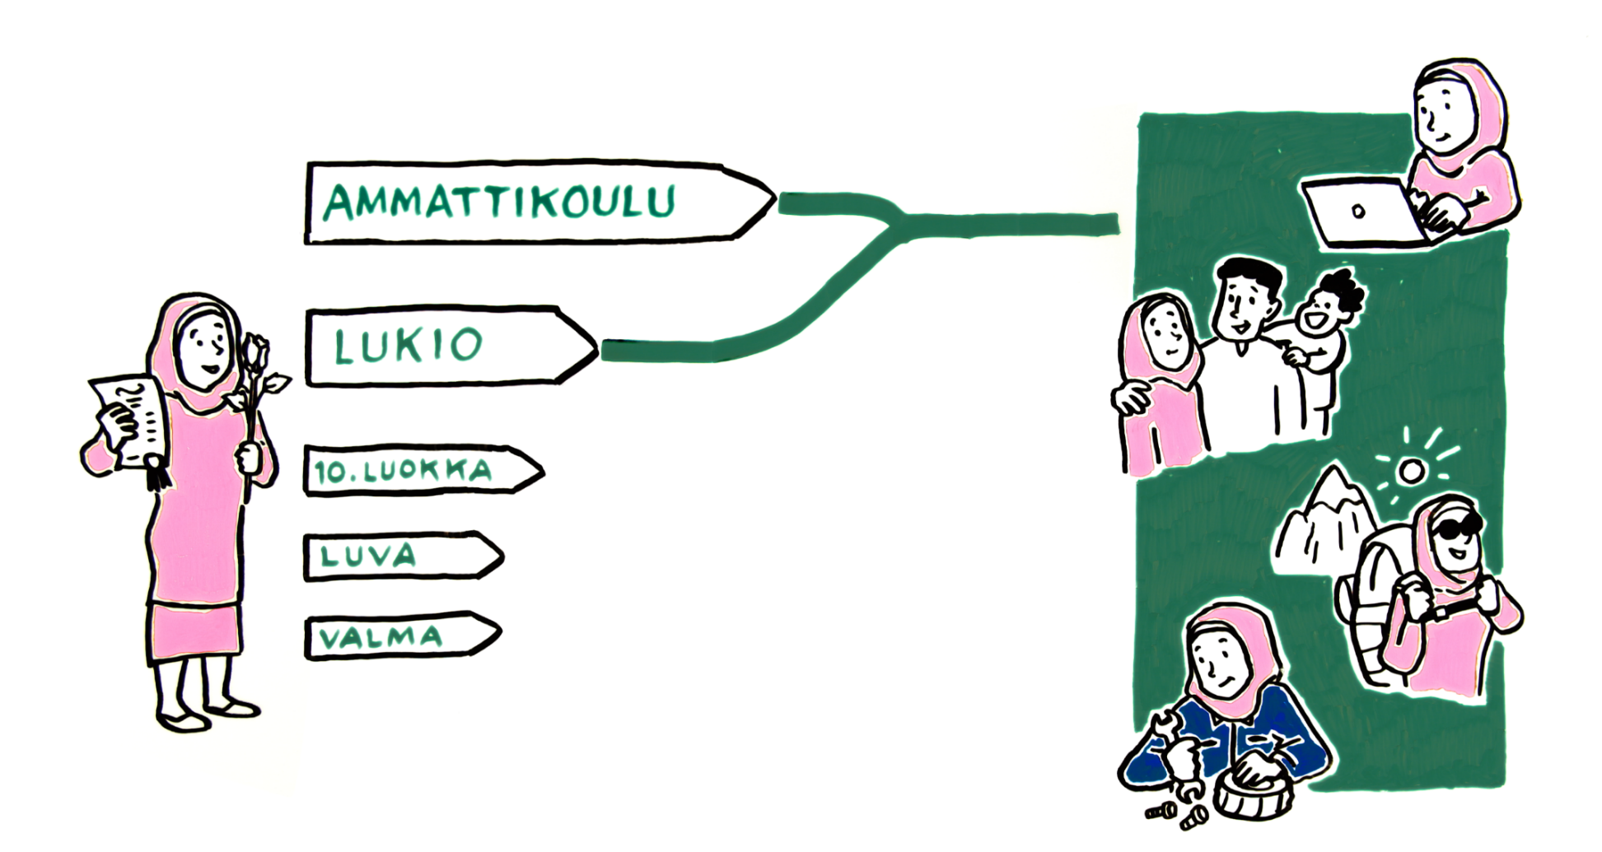
Life after graduation
After basic education, students apply for vocational education, upper secondary or preparatory education. All students who complete their basic education are prepared for further studies and for life after graduation.

