Slide 1
Education is teamwork between the family and the school

Slide 2
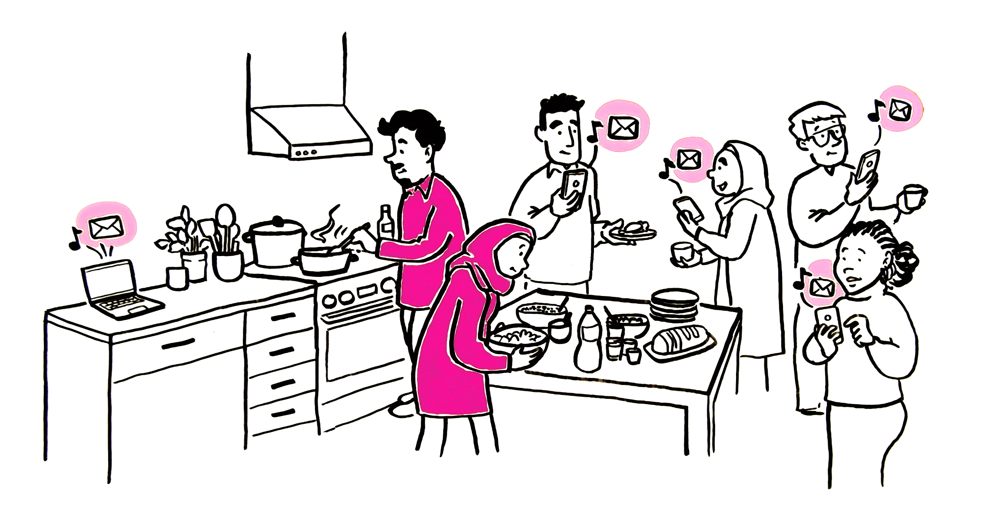
I thought my child was having some problems at school,
as I often received messages from their teacher.
I soon learned that the school regularly contacts all parents.

Slide 3
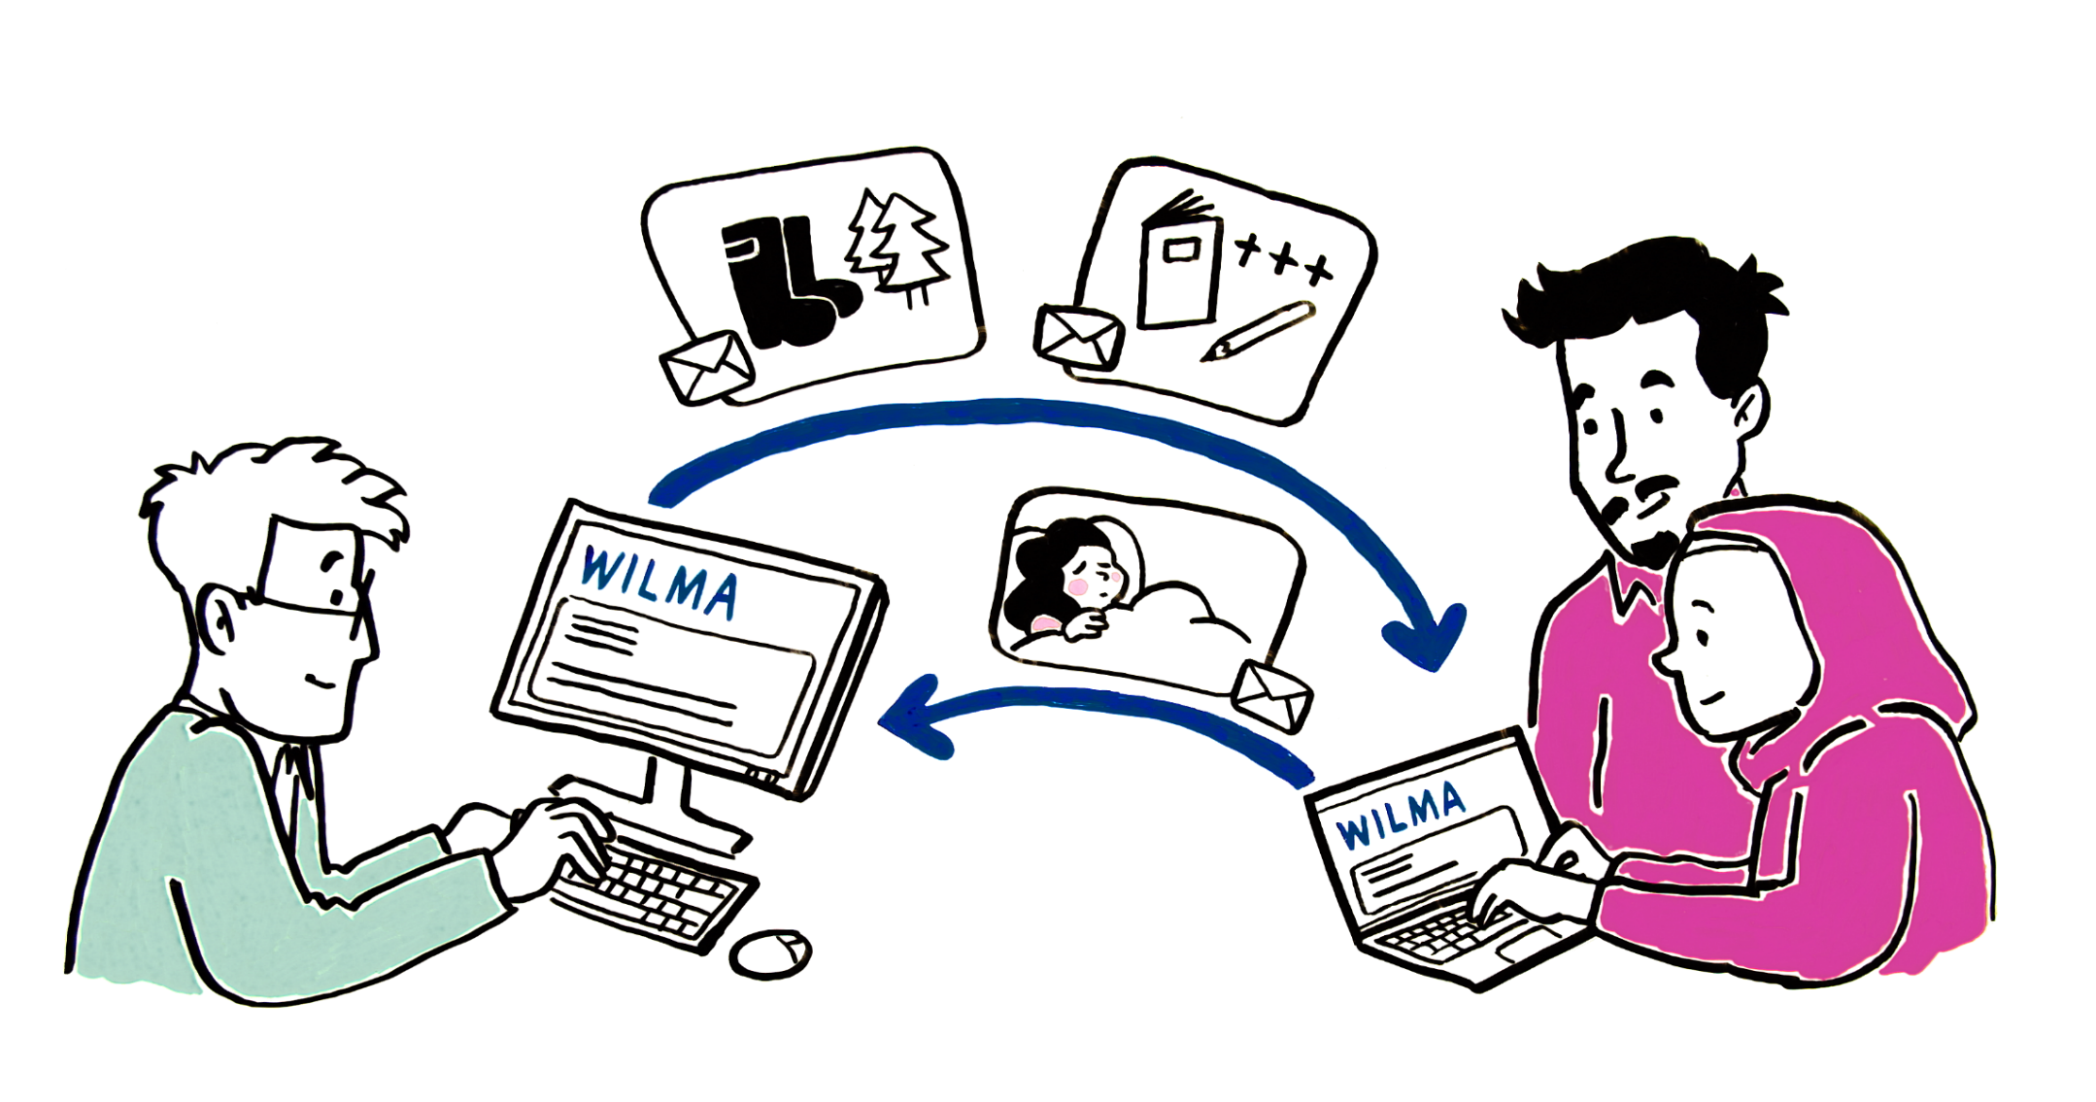
Usually, teachers send online messages using the Wilma web interface.
The messages are often about class excursions or schooling progress updates, things like that. In turn, I will send the teacher a Wilma message if, for example, my child is ill and staying home from school.

Slide 4
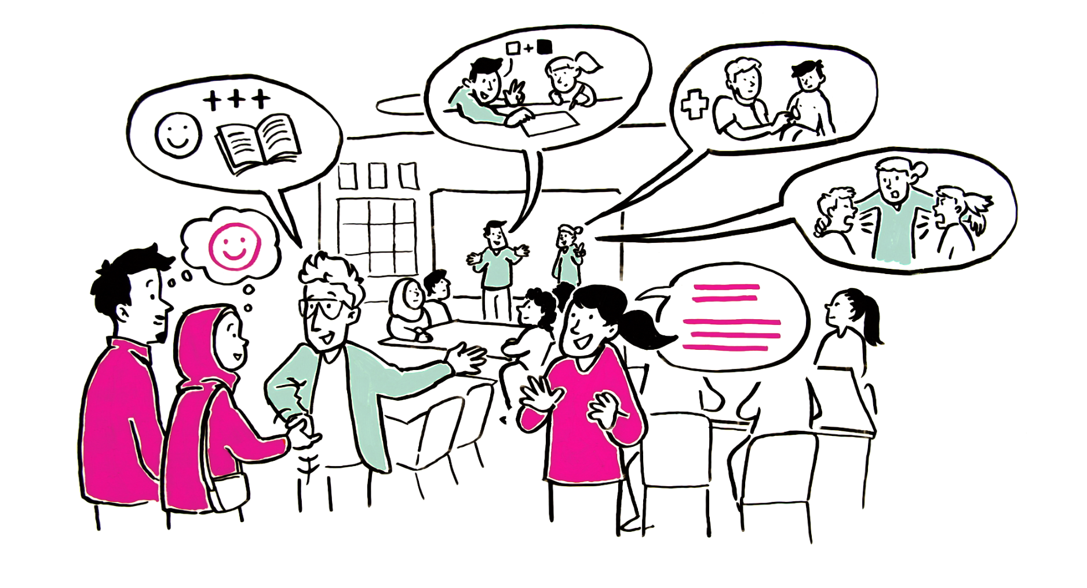
Most schools organize parents’ evenings. There I’ve been able to meet other parents and received important information about my child’s education. I also heard that all children can receive support for their own learning and well-being as needed. At the school I can also be assisted by an interpreter, because I’m still not able to converse very well with the teacher in Finnish.

Slide 5
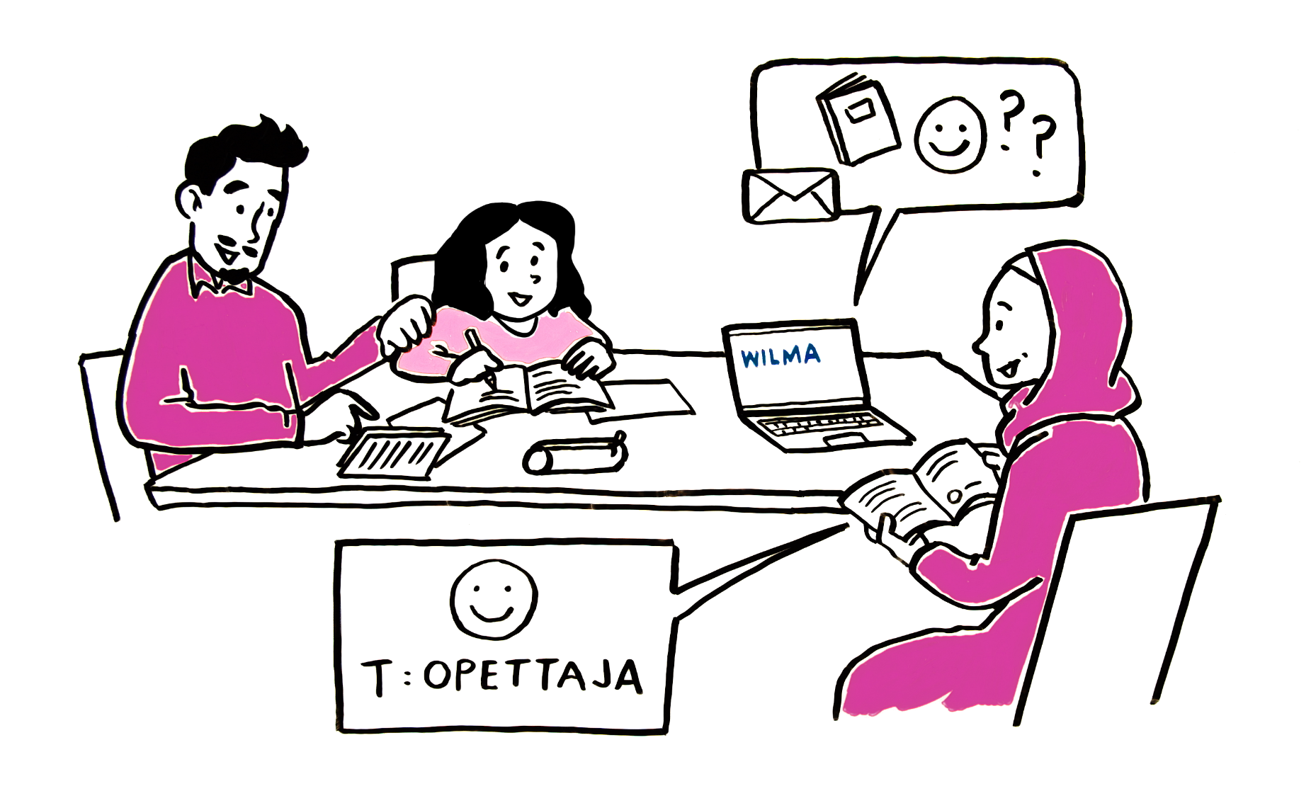
I have found that my child benefits from me being in active contact with their school and teachers. This way it’s easier for me to help my child if they face any challenges in their learning. When we encourage our children together, it motivates them to study and complete their tasks.

